Slide 1




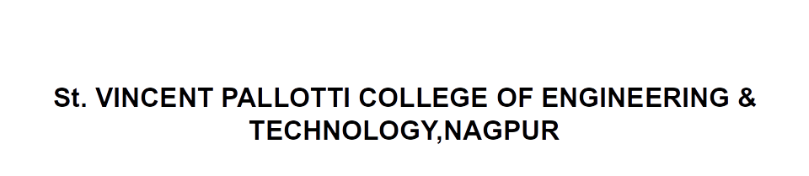
Open Elective –III Transportation System
CV705T

Slide 2

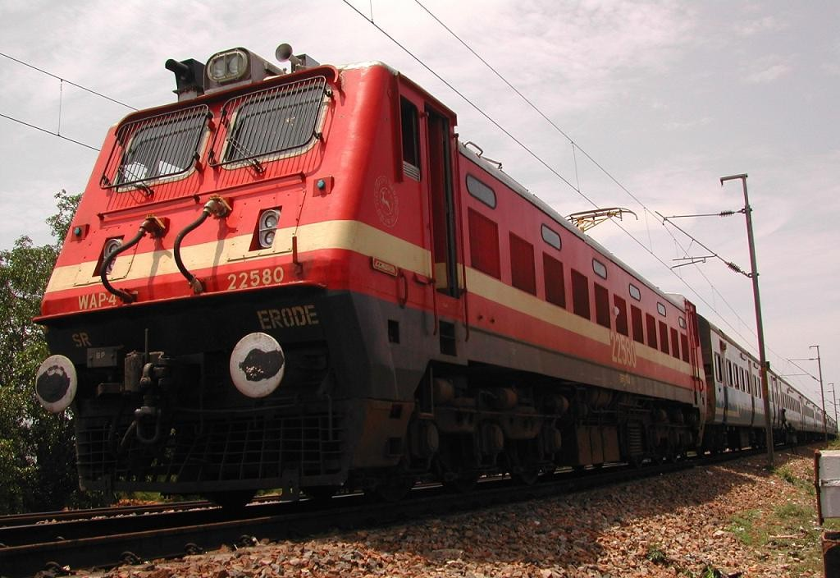

Slide 3
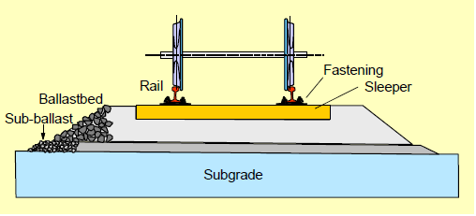
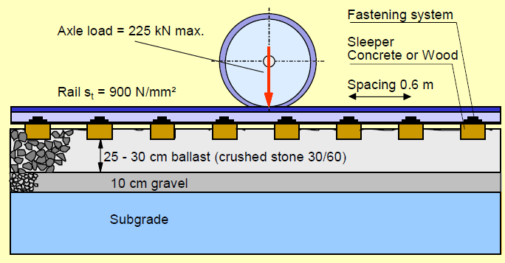
Track Formation
The purpose of track is to transfer train loads to the formation.
Requirements for Choosing a Track System:
Trains running on Track do not cause excessive environmental pollution in the form of noise and ground vibration.
Costs of the total service life of the track must be as low as possible.
Maintenance should be low and as inexpensive as possible

Slide 4
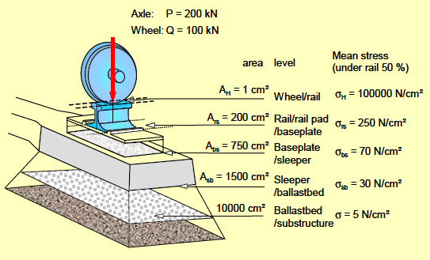

Load Bearing Function of the Track
The load transfer works on the principle of stress reduction - layer by layer.
The greatest stress occurs between wheel and rail and is in the order of 30 kN/cm2 (= 300 MPa).
Between rail and sleeper the stress is two orders smaller and diminishes between sleeper and ballast bed down to about 30 N/cm2.
Finally the stress on the formation is only about 5 N/cm2.

Slide 5
Type of Railway System
1.Urban Railway Transit: Urban rail transit is an all-encompassing term for various types of local rail systems providing passenger service within and around urban or older suburban areas.
Types :
Tram : Trams are systems that run mainly or completely along streets, with low capacity and frequent stops. Passengers usually board at street- or curb-level

Slide 6
Light Rail : Light rail is a relatively new term, as an outgrowth of trams/streetcars. Speeds are usually higher, and articulated vehicles may be used to increase capacity.
Rapid Transit: A rapid transit, underground, subway, tube, elevated, or metro(politan) system is a railway—usually in an urban area—with a high capacity and frequency of service, and grade separation from other traffic.

Slide 7
Mono Rail: Monorail is a metro or railroad with a track consisting of a single rail (actually a beam), as opposed to the traditional track with two parallel rails. Monorail vehicles are wider than the beam they run on.

Slide 8
Type of Railway System
Suburban/Rural Railways: Suburb mostly refers to a residential area. They may be the residential areas of a city, or separate residential communities within commuting distance of a city.
Types :
Regional/Commuter Rail : Commuter rail, also called suburban rail, is a passenger rail transport service between a city center, and outer suburbs and commuter towns or other locations that draw large numbers of commuters—people who travel on a daily basis. Regional rail or commuter rail runs on trackage often shared with intercity rail and freight trains

Slide 9
Continue…..
Intercity Rail: Inter-city rail services are express passenger train services that cover longer distances than commuter or regional trains.
Freight Trains: A freight train or goods train is a group of freight cars (US) or goods wagons (UIC) hauled by one or more locomotives on a railway, ultimately transporting cargo between two points as part of the logistics chain.

Slide 10
Permanent Way Materials
Rails
Concrete Sleepers
Fastenings
Switches & Crossings (Turnouts)

Slide 11


